Slide 1

Estimation & Learning In Aerospace
Academic Year: 2024-2025
Piercarlo Fontana
Professor. Marco Lovera
23/07/25
Dynamics of a Multirotor UAV
Notes:
“Good [morning/afternoon], my name is [Your Name], and today I’ll present the work I carried out for the Estimation and Learning in Aerospace exam project for the 2024/2025 academic year.
The project focuses on the identification and validation of models for the longitudinal dynamics of a multirotor UAV. I explored both grey-box and black-box identification methods, and compared their performance through a Monte Carlo analysis under different noise realizations. Let’s begin with an overview of the project structure and objectives.”

Slide 2
Project Task Overview
Task 1: Grey-box Identification
T1.1) Identify a grey-box model for the longitudinal dynamics of the multirotor using a sine sweep
T1.2) Assess uncertainty of the parameters estimated in terms of asymptotic variance
T1.3) Generate a 3211 sequence and use it to validate identified model
Task 2: Black-box Identification
T2.1) Implement the PBSID & structuring method
T2.2) Validate it using a first order example
T2.3-.4) Identify a black box model for the longitudinal dynamics of the UAV & estimate its parameters
T2.4) Validate the model using the 3211 sequence constructed before
Task 3: Monte Carlo Simulation
T3.1) Compare the two models, in terms of parameters, zeros, poles and frequency response
T3.2) Identify N pairs of models for the longitudinal dynamics, using the sine sweep and
hanging noise realisations
T3.3) Statistical analysis in terms of hystograms of estimated parameters & poles\zeros
Fontana
Notes:
Task 1 focuses on a grey-box identification of the UAV’s longitudinal dynamics using the known physical structure of the system. We also assess the uncertainty of the estimated parameters and validate the model using a 3211 input sequence.
Task 2 involves a black-box identification approach. I implemented the Predictor-Based Subspace Identification (PBSID) method and a structuring technique to align the black-box model with a physically meaningful one. The identified model is also validated using the same 3211 sequence.
Finally, in Task 3, I compare the performance of the two identification methods using a Monte Carlo analysis, where I generate multiple noise realizations while keeping the excitation input constant. This allows me to study robustness and statistical properties like parameter bias and frequency response variability.

Slide 3
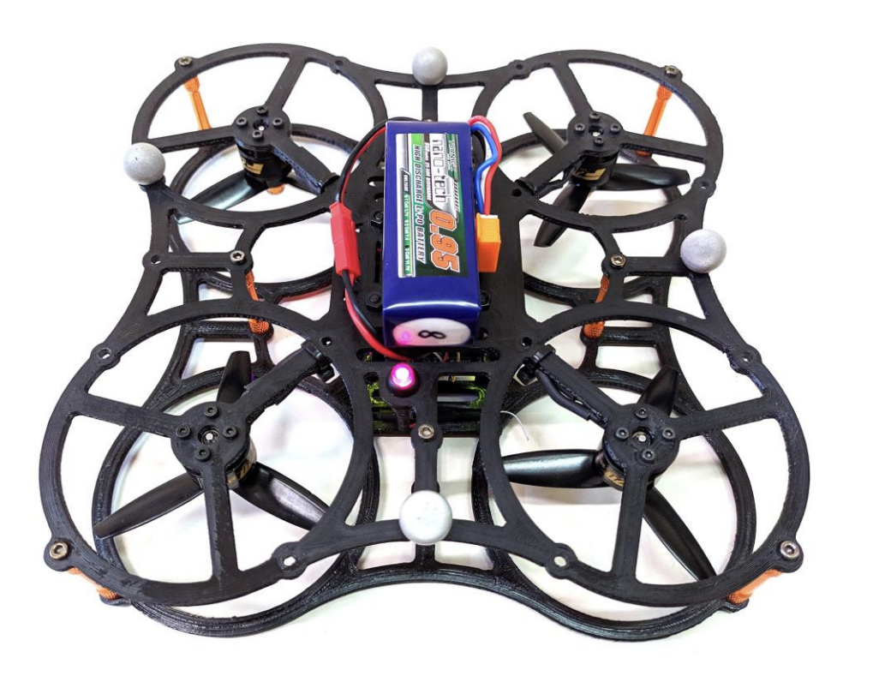
The quadrotor
Small Multirotor UAV
Weigth: 270 g
Size: 20x20 cm
Fontana
Notes:
The platform used in this project is a small multirotor UAV, with the following characteristics:
A total weight of 270 grams,
A compact size of 20 by 20 centimeters,
And a motor-to-motor diagonal of 16 centimeters.
It is equipped with a standard attitude and position control system, and is capable of hovering for up to 7 minutes and 30 seconds.
This setup is representative of many small UAVs used in research, and the simulator provided replicates its closed-loop longitudinal dynamics for identification and validation purposes.
The next slides present the input-output signals and model structure used for the identification process.”

Slide 4
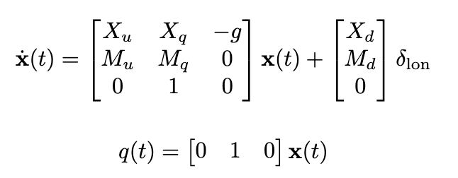
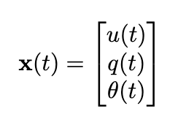
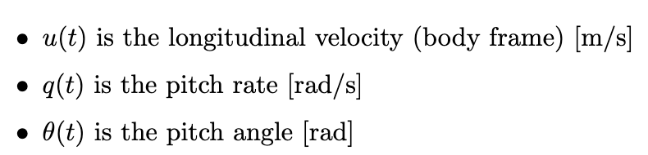
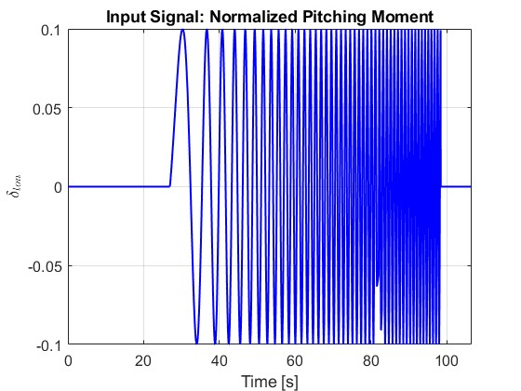
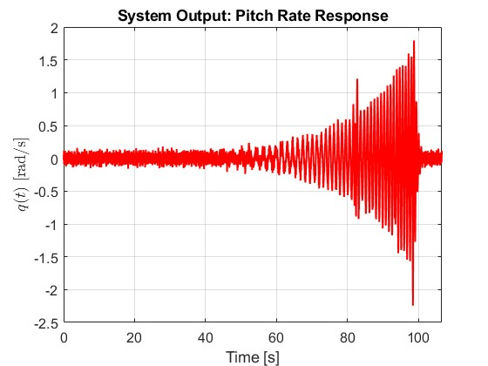
The Linearized Dynamics Model & ExcitationM
System identified by 6 parameters: $X_{u}$, $X_{q}$, $M_{u}$, $M_{q}$, $X_{δ}$, $M_{δ}$
The data comes from the Simulink model, which is configured with standard measurement noise and includes known delays.
Fontana
Notes:
“This slide summarizes the setup used for identifying the UAV’s longitudinal dynamics.
The model I'm working with has six parameters, and the only output of interest is the pitch rate q(t)q(t)q(t).
The input sequence is a sine sweep, which is used to excite the dynamics of the system. The data comes from the Simulink model, which is configured with standard measurement noise and includes known delays.
To focus the identification purely on rotational motion, I’ve removed the longitudinal acceleration from the output.
The resulting output from the simulation is then passed to the identification algorithm for both grey-box and black-box analysis.”

Slide 5
TASK 1
Grey-Box
Fontana

Slide 6
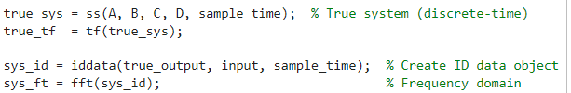
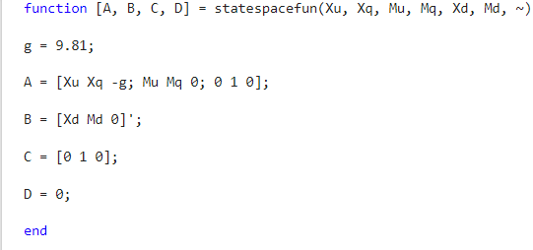
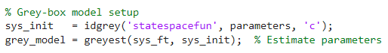
Grey-Box Identification Workflow
Create iddata object with input & output
Convert into frequency domain
Function used to impose structure
Pass the physical model to idgrey
Estimate parameters using greyest
Fontana
T1.1 – Grey Box Model Identification
Notes:
n this task, I identified a grey-box model for the UAV’s longitudinal dynamics using the response to the sine sweep input.
The first step was to create an iddata object in MATLAB using the simulated input and output signals.
Then, I converted the data into the frequency domain, which is more suitable for identifying dynamics over a range of frequencies.
I used the idgrey function to pass a structured physical model of the system, based on known dynamics and parameterized equations.
Finally, I applied the greyest function to estimate the model parameters from the frequency-domain data.
This workflow enables the use of prior physical knowledge while still fitting the model to real data, combining interpretability with data-driven accuracy.”

Slide 7
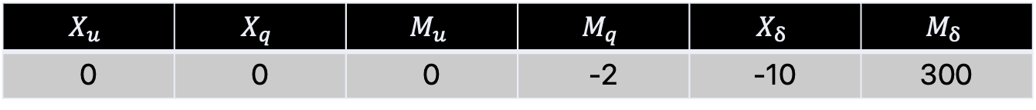
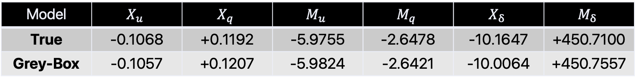
Grey-Box Identification Results
$$X_{u}$$ | $$X_{q}$$ | $$M_{u}$$ | $$M_{q}$$ | $$X_{δ}$$ | $$M_{δ}$$
0 | 0 | 0 | -2 | -10 | 300
Initial Guess
Model | $$X_{u}$$ | $$X_{q}$$ | $$M_{u}$$ | $$M_{q}$$ | $$X_{δ}$$ | $$M_{δ}$$
True | -0.1068 | +0.1192 | -5.9755 | -2.6478 | -10.1647 | +450.7100
Grey-Box | -0.1057 | +0.1207 | -5.9824 | -2.6421 | -10.0064 | +450.7557
getcov() to extract the covariance matrix from the identified model, the 1-sigma standard deviations are obatained from its diagonal component
1-σ($X_{u}$) | 1-σ($X_{q}$) | 1-σ($M_{u}$) | 1-σ($M_{q}$) | 1-σ($X_{δ}$) | 1-σ($M_{δ}$)
4.7825e+14 | 8.5966e+13 | 1.9967 | 4.7824e+14 | 2.7151e+18 | 1.5240e+04
Model output aligns well with the data: fit to data is of 94.88%
Estimated parameters are close to the true ones
Uncertainties are huge for some parameters, meaning that they are not uniquely identifiable, with multiple combinations producing the same behaviour
Fontana
T1.2 – Assess uncertainty of the parameters estimated
Notes:
After estimating the grey-box model, I assessed the uncertainty of the parameters using the getcov() function in MATLAB.
This function extracts the covariance matrix of the parameter estimates. From this, the 1-sigma standard deviations can be computed directly from the diagonal.
As shown in the results:
The model output matches the simulated data well, with a fit of 94.88%, which confirms a good estimation.
The estimated parameters are close to the true values used in simulation.
However, some parameters show very large uncertainty, which means they are not uniquely identifiable. In other words, multiple combinations of parameters can produce similar system behavior.
This highlights a common challenge in grey-box identification: while the model is physically interpretable, some parameters may be hard to estimate precisely.”

Slide 8
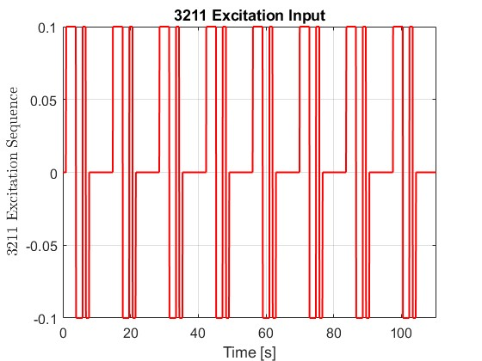
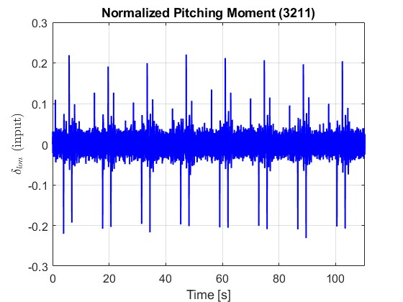
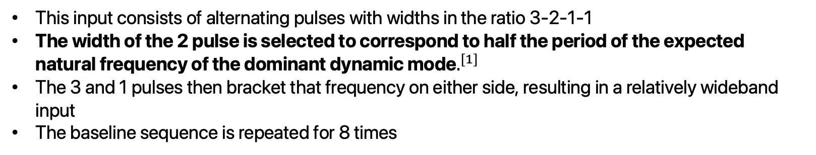
3211 Sequence
This input consists of alternating pulses with widths in the ratio 3-2-1-1
The width of the 2 pulse is selected to correspond to half the period of the expected natural frequency of the dominant dynamic mode$.^{[1]}$
The 3 and 1 pulses then bracket that frequency on either side, resulting in a relatively wideband input
The baseline sequence is repeated for 8 times
Dominant Mode: 3.2407 rad/s
Duration of the ‘2’ pulse: 0.9694 s
[1] Vladislav Klein and Eugene A. Morelli. Aircraft system identification: theory and practice. AIAA education
series. American Institute of Aeronautics and Astronautics, Reston, VA, 2006.
Fontana
T1.3 – Generate a 3211 sequence
Notes:
To validate the identified model, I generated a 3211 input sequence. This is a type of broadband excitation signal composed of alternating pulses with durations in a 3-2-1-1 ratio.
The key idea behind this sequence is that the ‘2’ pulse is designed to excite the system at its dominant natural frequency, while the ‘3’ and ‘1’ pulses provide excitation slightly below and above that frequency.
In this case, the dominant mode was estimated to be 3.2407 radians per second, based on the largest eigenvalue of the identified system.
The duration of the ‘2’ pulse was set to 0.9694 seconds, which is half the period of that frequency. The sequence was repeated 8 times to ensure sufficient data for validation.
This 3211 input will now be used to test the grey-box model outside of the training data.”

Slide 9
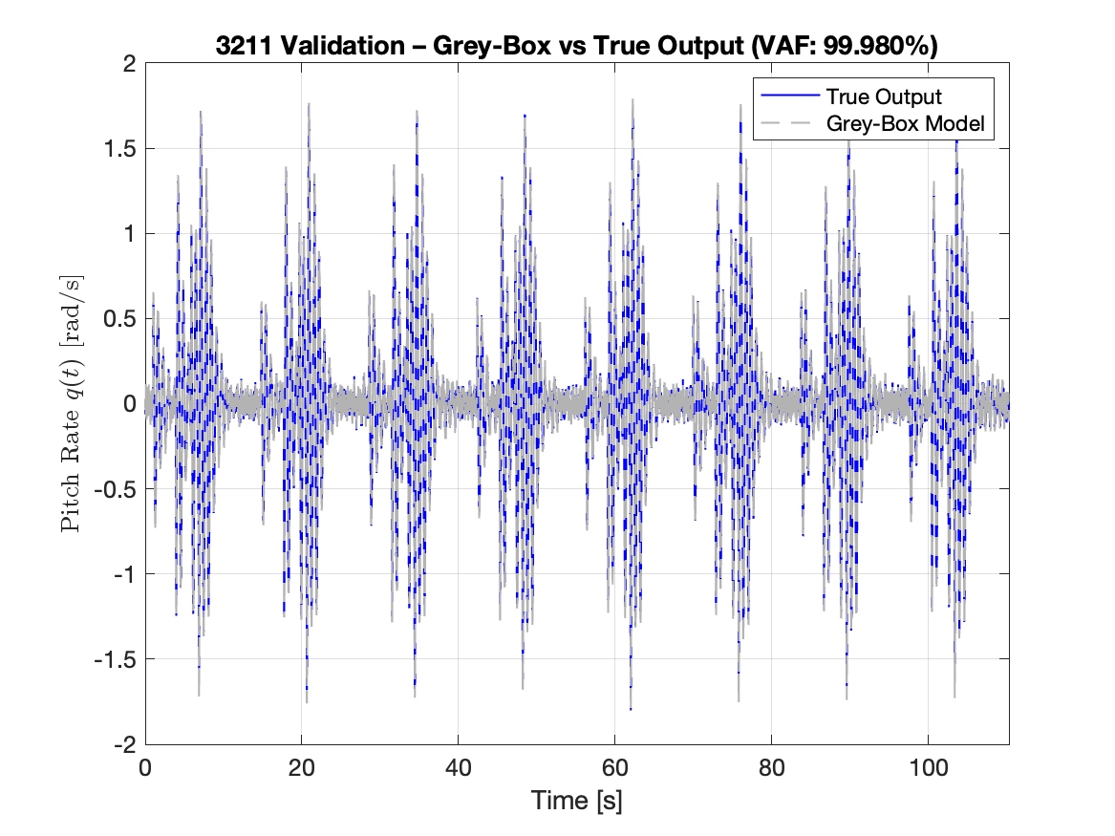
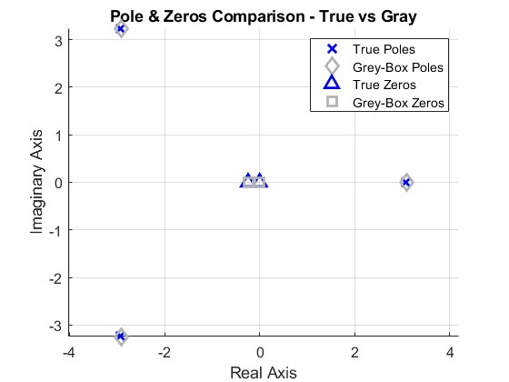
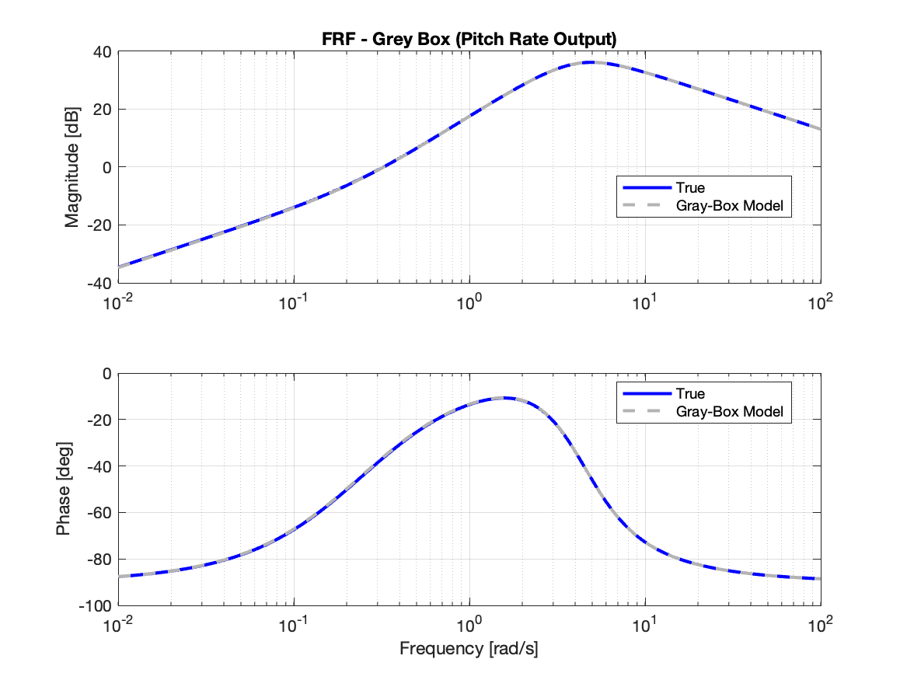
Grey-Box Validation Results
True
Gray-Box
Poles | Zeros
-2.920 + 3.238i | -0.242
-2.920 -3.238i | 0
3.084
Poles | Zeros
-2.917 + 3.241i | -0.239
-2.917 - 3.241i | 0
3.087
Type | Value
VAF | 99.9802
FIT | 99.9802%
PEC | 4.3361e-05
Fontana
T1.3 – Use the 3211 sequence to validate
Notes:
This slide shows the validation results using the 3211 sequence I just described.
The goal here is to test whether the grey-box model, identified from the sine sweep input, can generalize well to a new type of excitation.
The model's output was simulated using the 3211 sequence as input and compared to the true simulated pitch rate from the system.
The results show a good alignment between the model response and the actual data, confirming that the model captures the dominant dynamics of the UAV accurately, even outside the original training input.
This completes the grey-box identification part of the project. Next, I’ll move to the black-box identification based on the PBSID method.
VAF: Measures how much of the variance in the output yyy is captured by the model output
FIT: Measures how well the model output matches the measured output, relative to just guessing the mean.
PEC: It's basically the mean squared prediction error. Lower PEC → better fit.

Slide 10
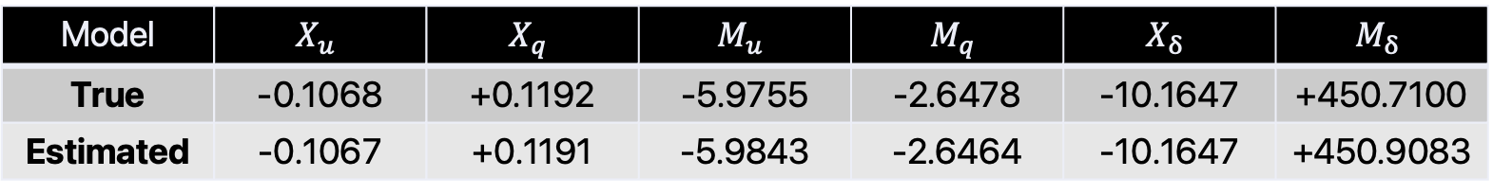
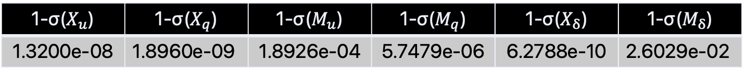
What happens if we also use the acceleration output?
Results significantly improve when also using the output on the longitudinal acceleration
This needs some tweaking on the structure function, to include the measurement model of the acceleration
Model | $$X_{u}$$ | $$X_{q}$$ | $$M_{u}$$ | $$M_{q}$$ | $$X_{δ}$$ | $$M_{δ}$$
True | -0.1068 | +0.1192 | -5.9755 | -2.6478 | -10.1647 | +450.7100
Estimated | -0.1067 | +0.1191 | -5.9843 | -2.6464 | -10.1647 | +450.9083
Also, covariances drop down:
1-σ($X_{u}$) | 1-σ($X_{q}$) | 1-σ($M_{u}$) | 1-σ($M_{q}$) | 1-σ($X_{δ}$) | 1-σ($M_{δ}$)
1.3200e-08 | 1.8960e-09 | 1.8926e-04 | 5.7479e-06 | 6.2788e-10 | 2.6029e-02
Fontana
T1.2 – Assess uncertainty of the parameters estimated
Notes:
After estimating the grey-box model, I assessed the uncertainty of the parameters using the getcov() function in MATLAB.
This function extracts the covariance matrix of the parameter estimates. From this, the 1-sigma standard deviations can be computed directly from the diagonal.
As shown in the results:
The model output matches the simulated data well, with a fit of 94.88%, which confirms a good estimation.
The estimated parameters are close to the true values used in simulation.
However, some parameters show very large uncertainty, which means they are not uniquely identifiable. In other words, multiple combinations of parameters can produce similar system behavior.
This highlights a common challenge in grey-box identification: while the model is physically interpretable, some parameters may be hard to estimate precisely.”

Slide 11
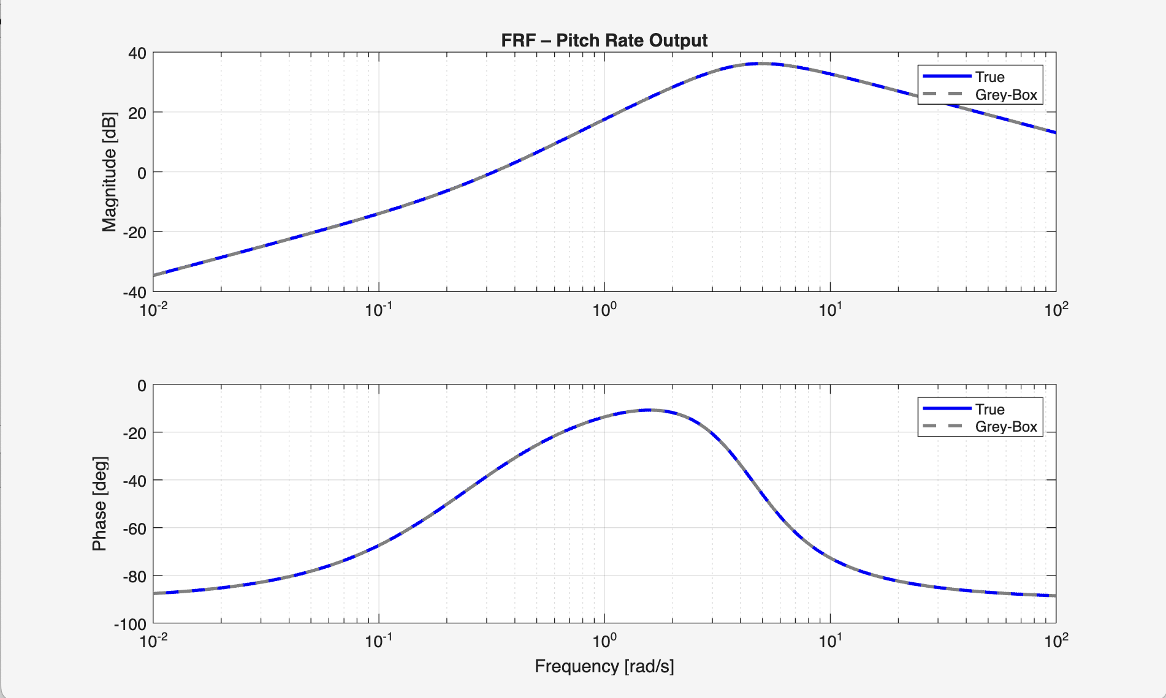
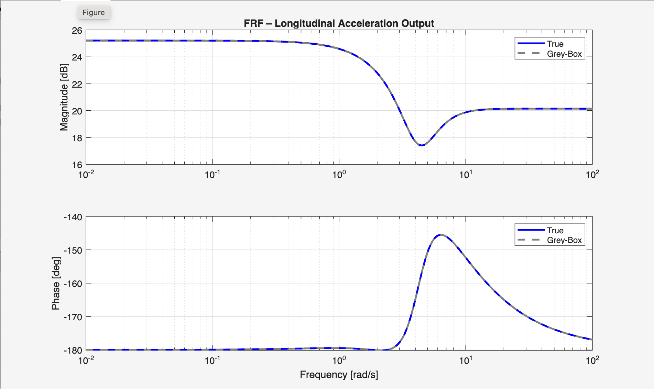
What happens if we also use the acceleration output?
Fontana
T1.2 – Assess uncertainty of the parameters estimated
Notes:
After estimating the grey-box model, I assessed the uncertainty of the parameters using the getcov() function in MATLAB.
This function extracts the covariance matrix of the parameter estimates. From this, the 1-sigma standard deviations can be computed directly from the diagonal.
As shown in the results:
The model output matches the simulated data well, with a fit of 94.88%, which confirms a good estimation.
The estimated parameters are close to the true values used in simulation.
However, some parameters show very large uncertainty, which means they are not uniquely identifiable. In other words, multiple combinations of parameters can produce similar system behavior.
This highlights a common challenge in grey-box identification: while the model is physically interpretable, some parameters may be hard to estimate precisely.”

Slide 12
TASK 2
Black-Box
Fontana

Slide 13
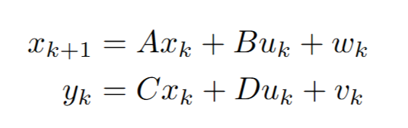
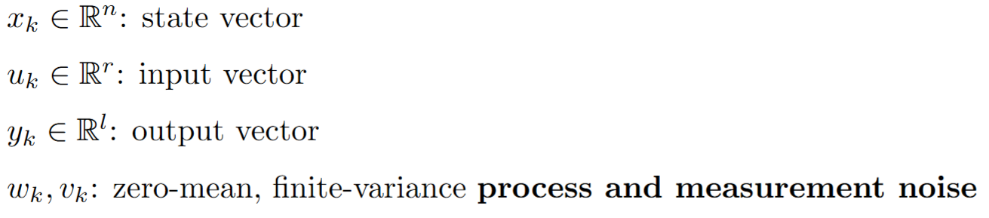
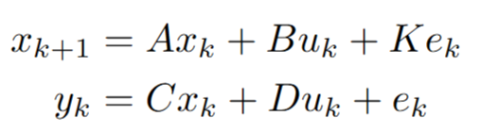
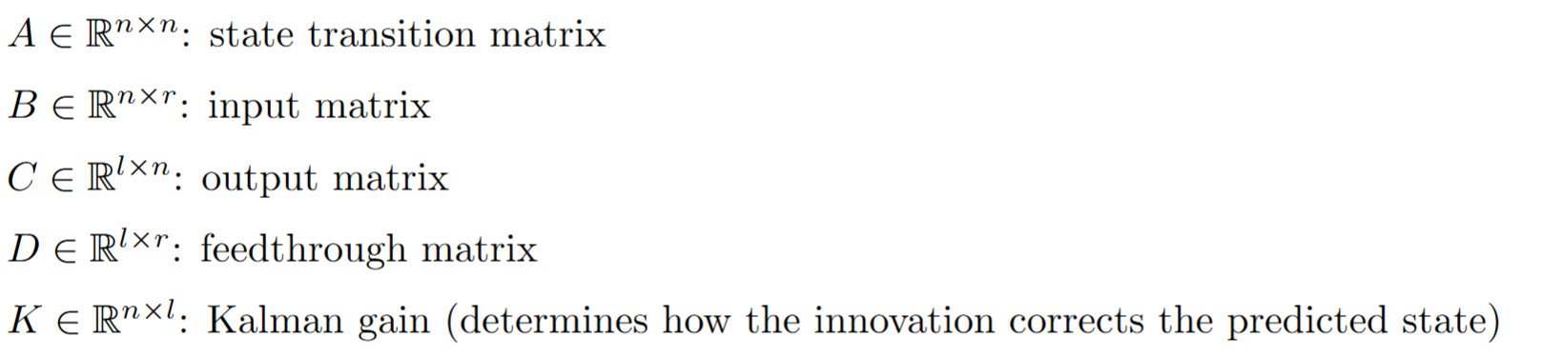
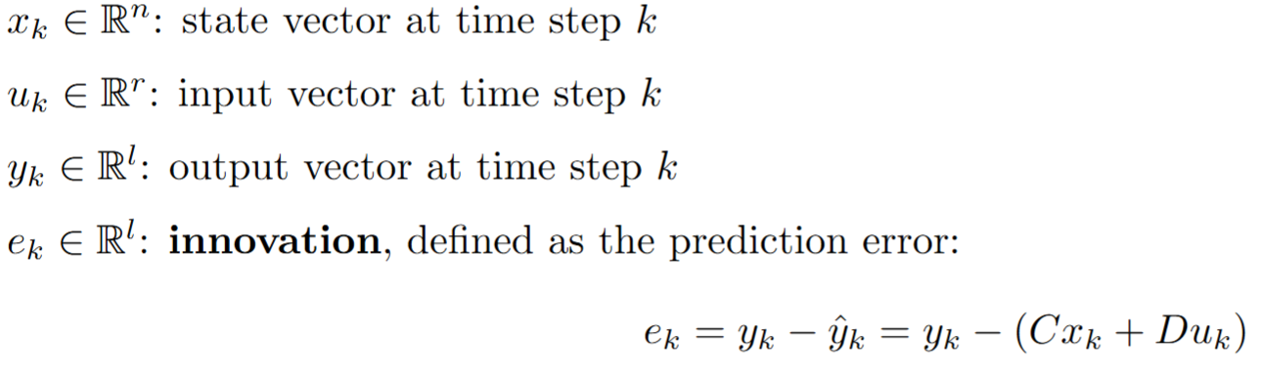
PBSID Implementation: Standard to Innovation Form
Consider a linear discrete state-space model having the following form:
Introducing the innovation e, it is possible to write the system into the so called Kalman innovation state-space model:
Fontana
T2.1 – Implementing the PBSID
Notes:
This slide introduces the Predictor-Based Subspace Identification method, or PBSID, used for black-box modeling.
The starting point is a standard discrete-time state-space model, which is then rewritten in what's called the Kalman innovation form, where the noise is modeled explicitly through the innovation term eee.
This formulation is essential because it allows us to reconstruct the internal states of the system from input-output data, even if the system is in closed loop.
PBSID builds a model by analyzing how past inputs and outputs influence future outputs, using matrices of so-called Markov parameters. These are estimated using least squares techniques.
This method is particularly suited to automated identification and gives a model that fits the data well, though it doesn’t necessarily have physical interpretability.
In the next slides, I’ll go into the estimation steps in more detail

Slide 14
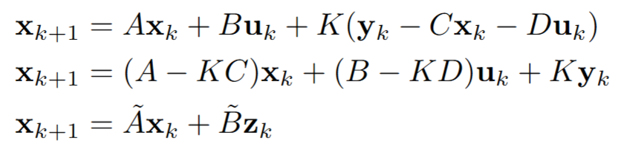
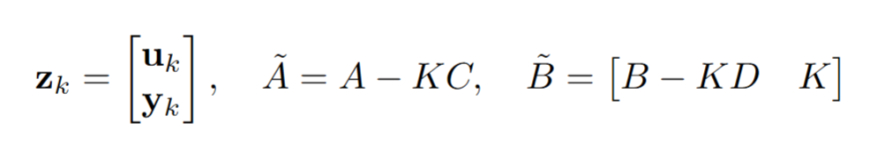
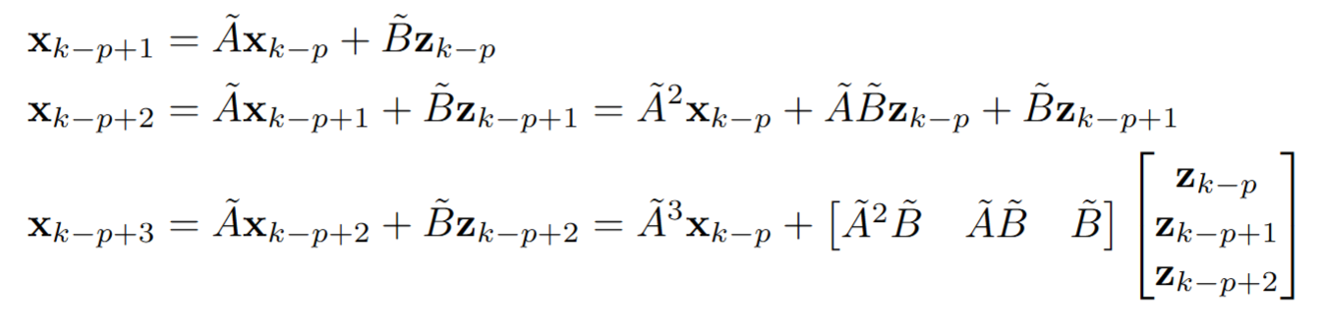
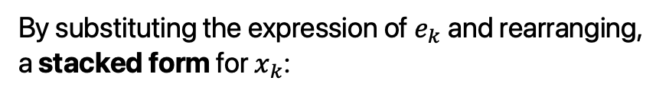
PBSID Implementation: Past Window parameter
By substituting the expression of $e_{k}$ and rearranging, a stacked form for $x_{k}$:
The past window, denoted by p, defines how many time steps of past data we consider when predicting future outputs.
Starting from the time instant k − p, and by performing recursive substitutions of equation, we obtain:
Fontana
T2.1 – Implementing the PBSID
Notes:
This slide explains the concept of the past window, denoted by the parameterp, in PBSID. A larger ppp gives more data history and might capture system dynamics better — but it also increases the dimensionality of the regression problem and can introduce noise sensitivity.
To estimate how the current state evolves from past data, we perform a sequence of recursive substitutions starting from time step k−pk - pk−p.
The idea is to express the current state as a linear combination of past input-output pairs, using a matrix of Markov parameters.
This results in a structure where the future state predictions depend on a stacked vector of past data. This formulation allows us to relate the unknown internal state to measurable quantities.
These past data vectors are then used to estimate the system dynamics using a least squares problem, which leads to the estimation of the Markov matrix.”

Slide 15
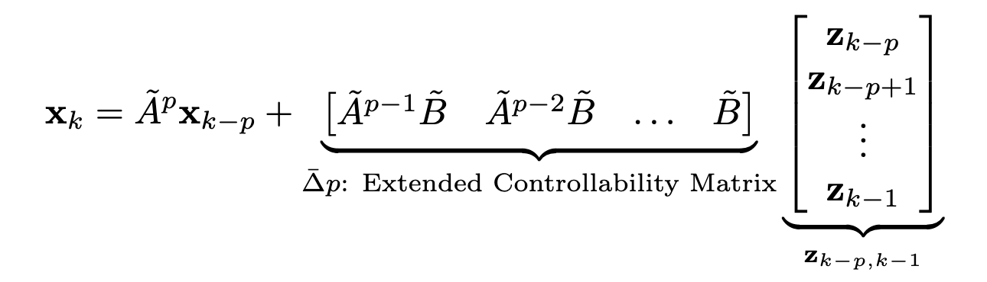
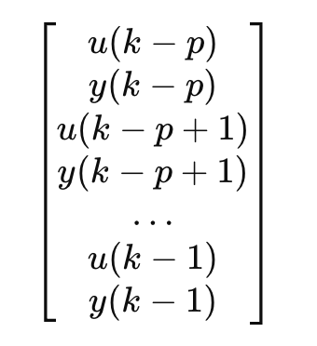
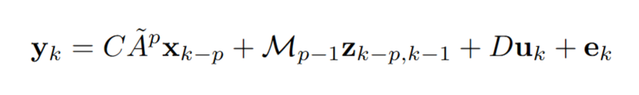
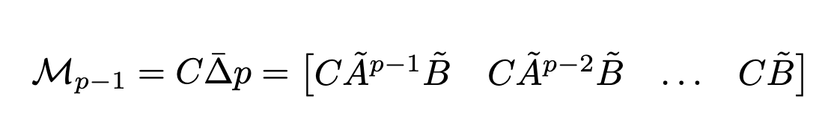
PBSID Implementation: Extended Controllability Matrix
Therefore, the general shape for the expression is:
By multiplying the measurement equation for the expression above:
Matrix of Markov parameters
Fontana
T2.1 – Implementing the PBSID
Notes:
With the past data window defined, we now move to estimating the Markov parameters matrix, which captures the system's input-output behavior over time.
This matrix defines how past input-output pairs influence the future state.
To compute it, I solve a least-squares problem that relates the future outputs to the stacked past data. The matrix solution gives the best fit in terms of minimizing the prediction error.
I used MATLAB’s pinv() function to compute the pseudo-inverse, which is needed because the matrix may not be square or well-conditioned.
Once we have the Markov matrix, we can use it to estimate the state sequence over time, which is the next step in the PBSID pipeline.”

Slide 16
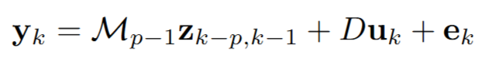
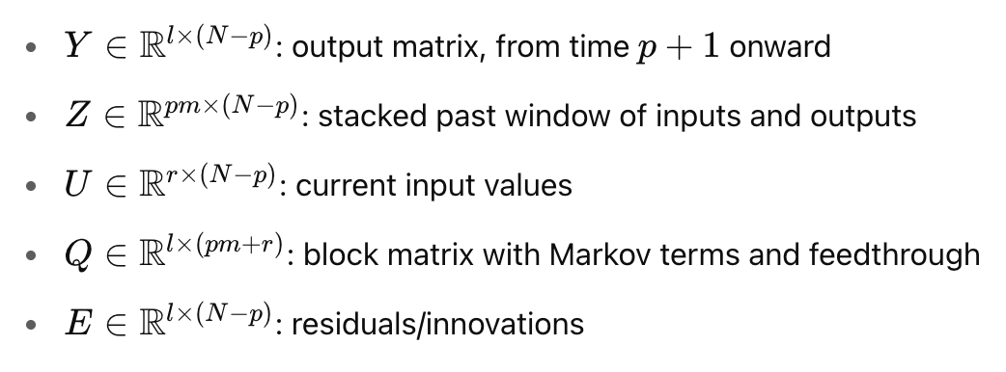
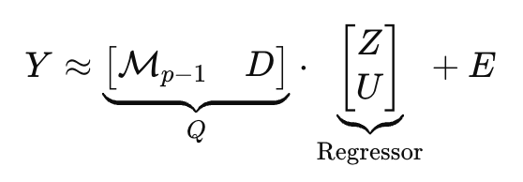
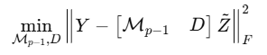
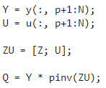
PBSID Implementation: Augmented Markov Matrix
For large values of p, $\tilde{A^{p}}≈0:$
N: Number of samples
l: Number of outputs
r: Number of inputs
m: l + r
n: System’s Order
Then, the Augmented Markov Matrix can be retrieved by solving a LS problem, whose solution is:
Solved using the MatLab command pinv(), to compute the pseudo-inverse
Fontana
T2.1 – Implementing the PBSID
Notes:
In this step, I construct the augmented Markov matrix, which helps estimate the system’s internal state sequence.
By introducing a second parameter, called the future window f, I build a matrix that combines the influence of multiple future time steps.
This augmented matrix includes stacked Markov parameters that relate past data to future state values across the prediction horizon.
The state sequence is then estimated by projecting the measured outputs onto this matrix, using Singular Value Decomposition — or SVD — which I’ll describe on the next slide.
The choice of ppp and fff greatly affects the accuracy of this estimation, and they are selected carefully through cross-validation.

Slide 17
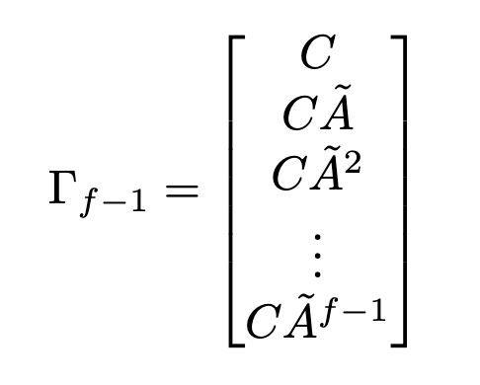
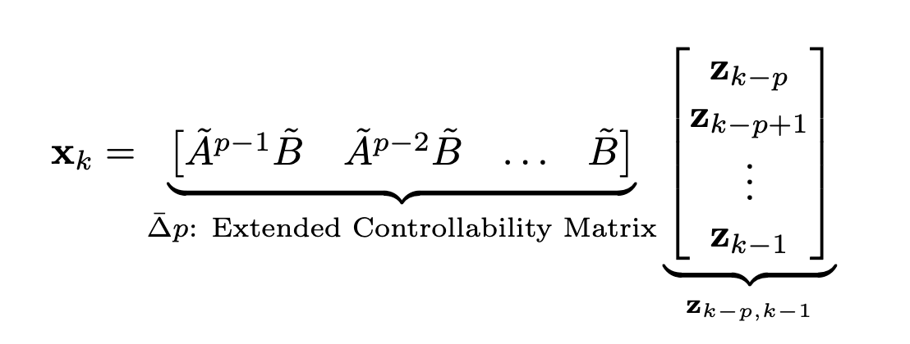
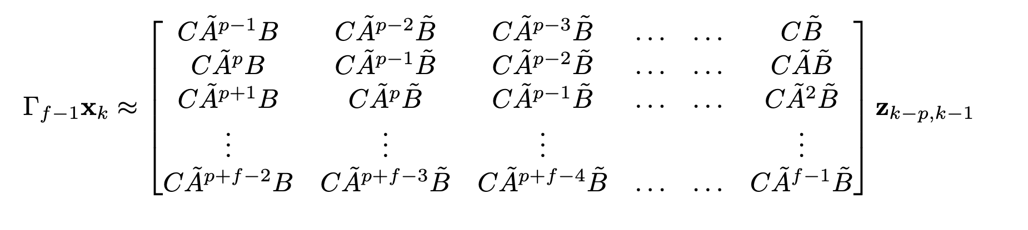
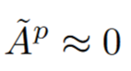
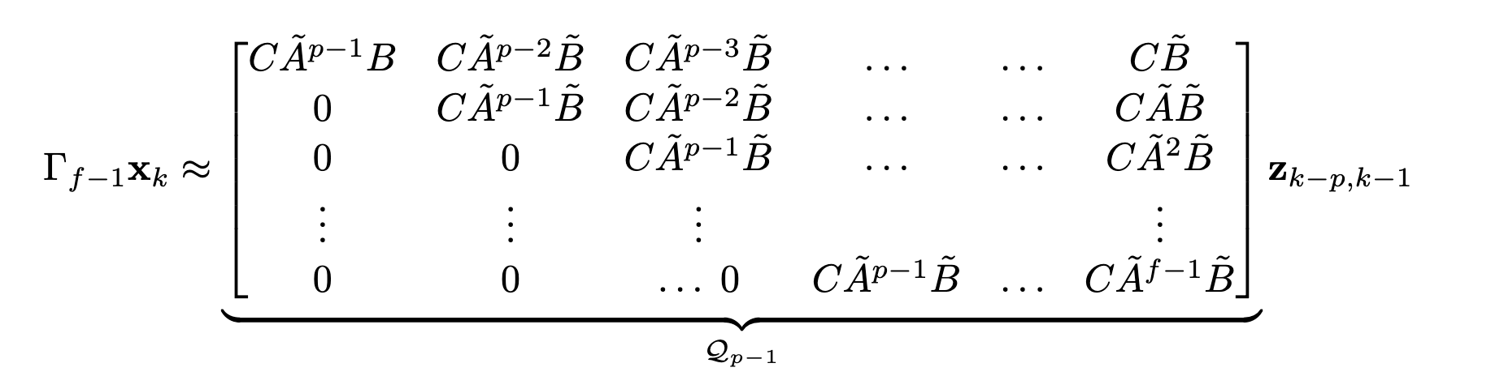
PBSID Implementation: Extended Observability Matrix
Once the Markov matrix parameters are estimated, we can proceed with the estimation of the state sequence. Introducing another parameter f called future window, we can define the following matrix:
Multiplying this equation by
Extended Observability Matrix
Fontana
T2.1 – Implementing the PBSID
Notes:
This slide introduces the Extended Controllability Matrix, which plays a central role in reconstructing the internal state dynamics.
The matrix is built using the previously estimated Markov parameters, organized across time steps based on the past window p and future window f.
Its structure captures how a sequence of past inputs drives the internal state forward through the system.
I iterated over different time indices k, from p to p+ℓp + \ellp+ℓ, to construct the complete matrix.
This controllability matrix is then used in the Singular Value Decomposition step, which extracts the most relevant state information from noisy data — and also helps estimate the model order.

Slide 18
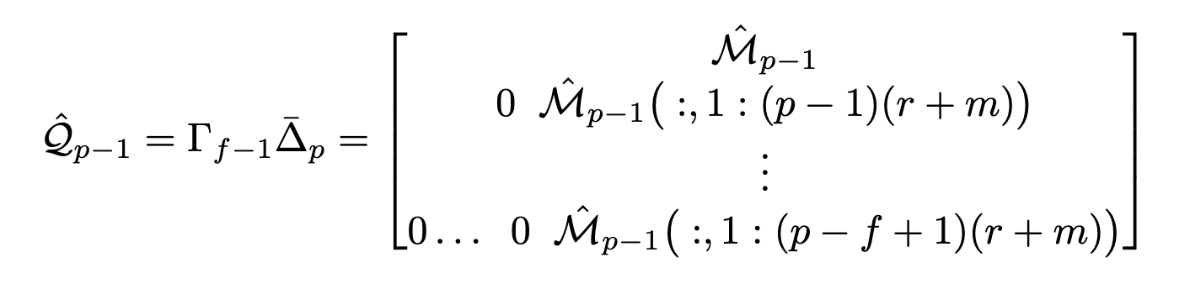
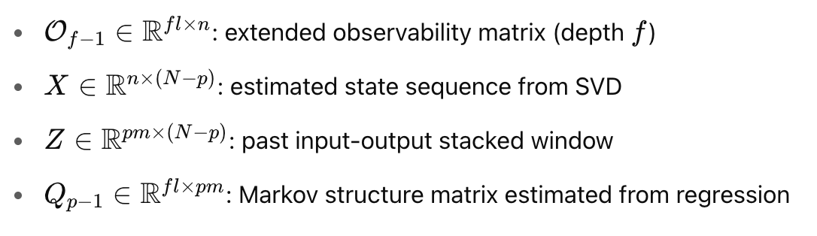
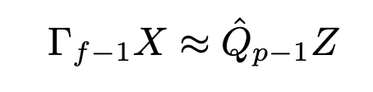
PBSID Implementation: Extended Observability Matrix
The matrix is formed by the previously found Markov Parameters Matrix, fixed by the number of past inputs p, the number of future inputs f, the number of input r and number of outputs m:
Unknown
Known
We are interested in obtaining an estimate of the matrix $\hat{X}$that represents the state sequence. However, the left-hand side of the equation is completely unknown and the right-hand side is known.
Fontana
T2.1 – Implementing the PBSID

Slide 19
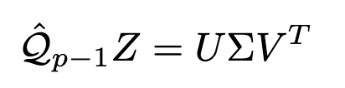
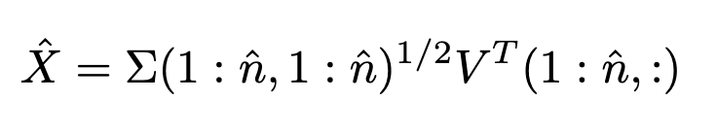
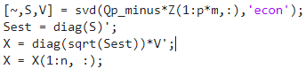
PBSID Implementation: SVD
$\text{We} \text{can} \text{obtain} \text{an} \text{estimate} \text{of} \text{the} \text{matrix} \hat{X} \text{by} \text{computing} \text{a} \text{row} \text{space} \text{of} \text{the} \text{matrix} \hat{𝒬_{p−1}}Z$, using singular value decomposition, implemented in MatLab using the command svd().
U, V are orthonormal matrices, and Σ is the matrix of singular values
Let $\hat{n}$ be the order of the system, then$\hat{X}$ can be easily computed as:
In MatLab
Fontana
T2.1 – Implementing the PBSID
Notes:
Once the extended controllability matrix is built, I perform a Singular Value Decomposition, or SVD, which is a critical step in PBSID.
SVD decomposes the matrix into three parts — UUU, Σ\SigmaΣ, and VVV — where:
Σ\SigmaΣ contains the singular values, sorted in descending order.
These singular values indicate the energy or importance of each state component in the data.
By plotting the singular values on a logarithmic scale, I can identify a large drop between values, which tells me the system order — or the number of dominant modes in the dynamics.
For example, a sharp drop after the first value suggests a first-order system. A slower decay may indicate a higher-order model is needed.
In my implementation, I tested both a first-order and a third-order system, using different combinations of ppp and fff, and compared their fit to the data.

Slide 20


PBSID Implementation: System Order Estimation
From the svd, the matrices U, V and Σ are obtained. By plotting the singular values of Σ using a logarithmic scale, a large gap between consecutive singular values denote the order of the system:
First Order System – p = 20 f = 10
Third Order System – p = 750 f = 300
Fontana
T2.1 – Implementing the PBSID
Notes:
This slide summarizes how the system order is determined using the singular values from the SVD.
The plots show examples of singular value spectra for two different cases:
On the left, for a first-order system, there’s a clear gap after the first singular value.
On the right, for a third-order system, we see three significant singular values before the drop.
This helps to visually identify the model order that best represents the underlying dynamics without overfitting to noise.
Choosing the correct system order is critical because:
Too low → underfitting and loss of important dynamics
Too high → overfitting and poor generalization
I used this insight to guide the selection of the order in the PBSID implementation, which I then used to estimate the full state-space model.

Slide 21


PBSID Implementation: C, D Estimation
Now that $\hat{X}$is estimated, it is possible to find the actual matrices A,B,C,D,K of the system. Starting from C,D, we recall that:
The output CD is a matrix containing C and D. By construction, C is represented by the first $\hat{n}$ columns while D is the columns going from $\hat{n}$ + 1 to $\hat{n}$ + r (the number of inputs):
Fontana
T2.1 – Implementing the PBSID
Notes:
After estimating the state sequence and determining the system order, the next step is to recover the output equation, which involves estimating the CCC and DDD matrices.
These matrices relate the internal state and the input to the system output.
Since we already have an estimate of the state sequence X^\hat{X}X^, we can set up another least squares problem using the output data.
This problem solves for CCC and DDD such that:
y(k)≈C⋅x^(k)+D⋅u(k)y(k) \approx C \cdot \hat{x}(k) + D \cdot u(k)y(k)≈C⋅x^(k)+D⋅u(k) This step is essential for accurately reconstructing the measured pitch rate from the estimated internal states and control inputs.
With CCC and DDD estimated, I then move on to the final step of recovering the full system dynamics — the AAA, BBB, and KKK matrices.

Slide 22



PBSID Implementation: A, B, K Estimation
Now that the joint matrix CD is estimated, it is possible to rearrange for $e_{k}$:
Then, from the following expression, a LS problem is built by substituting $e_{k}$:
Known
Unknown
Known
Like before, the unknows the LS can be solved using the pseudo-inverse of S. By construction, A is the first $\hat{n}$ columns of Q, B is the columns going from $\hat{n}$+1 to $\hat{n}+r$ , while K goes from $\hat{n}+r+1$ to end
Fontana
T2.1 – Implementing the PBSID
Notes:
his final step completes the black-box model by estimating the state dynamics, which are governed by the matrices AAA, BBB, and KKK.
AAA models how the state evolves over time,
BBB captures how the input influences the state,
And KKK is the Kalman gain, which models the influence of the innovation or noise.
Using the previously estimated state sequence and innovation residuals, I solve yet another least-squares problem to estimate these matrices.
The result is a complete discrete-time, linear state-space model, which fits the observed data well, but — unlike the grey-box model — does not have an immediate physical interpretation.
That’s where the next step comes in: I’ll use a structuring method to map this black-box model into a structured, physically meaningful form.

Slide 23

Structuring Implementation
The PBSID just provide one possible model which fits well the output data; it doesn’t hold any physical meaning
Structuring aligns the identified black-box model with a grey-box model structure using frequency domain data
Convert black box mode into frequency domain
freq_vec is the range of frequency in which the fitting is evaluated
Create a grey-box model based on the actual system
Estimate grey-box parameters, using greyest
Huge dependance on the f, p, n values
Very sensitive on the initial guess for the parameters
Fontana
T2.1 – Implementing the structuring method
Notes:
This slide introduces the structuring method, which is used to give physical meaning to the black-box model identified by PBSID.
The idea is to align the PBSID model — which is accurate but unstructured — with a grey-box model structure that reflects the known physics of the system.
The steps are:
Convert the black-box model into the frequency domain.
Define a grey-box model using the actual system structure and parameterized dynamics.
Use greyest to fit the grey-box model so that its frequency response matches that of the black-box one.
One critical detail is the frequency range used for the matching, controlled by a vector freq_vec. The choice of this range is important to focus the fit where the data is most informative.
This process allows us to take advantage of the black-box model’s accuracy while recovering physically interpretable parameters, which can be compared directly with the grey-box estimates from Task 1.

Slide 24




Simple First Order System Experiment
Validation of PBSID & Structuring on a simple first order thermal system
$τ$: Thermal Time Constant [s]
K: Steady-State Gain [*C/input]
Assuming $τ$ = 1 & K = 3 A = -1, B = 3, C = 1, D = 0
The system is excited with random input between 0 and 1, and a small noise is added to it
The PBSID is called using p = 20, f = 10
The order of the system, which is a first order, can be estimated by looking at the following graph, which shows the singular value decomposition
Then, the structuring approach gives estimates for the parameters $τ$ and K
Fontana
T2.2 – Simple First Order System Experiment
Notes:
Before applying PBSID and the structuring method to the UAV model, I first validated the implementation using a simple first-order thermal system.
This is a standard benchmark model with known dynamics, and it’s useful for confirming that the algorithm works correctly.
I applied PBSID to estimate a black-box model from simulated input-output data, and then used the structuring method to recover the original physical parameters.
This step ensures that the identification and parameter estimation pipeline is functioning as expected — especially for interpreting parameters after structuring.

Slide 25




Experiment Structuring & Validation
Type | Value
VAF | 99.9968
FIT | 99.9964%
PEC | 1.8964e-06
Using the structuring identification, the following parameters were estimated
Parameter | True | Estimated
$$τ$$ | 1 | 0.9887
$$K$$ | 3 | 2.9827
The estimated system was then validated on a chirp input sequence
Fontana
T2.2 – Simple First Order System Experiment
Notes:
Here I show the results of the structuring method applied to the simple first-order system.
After structuring, I was able to estimate parameters that are very close to the true ones, which confirms that the pipeline is working correctly.
The system was then validated using a chirp input sequence, and the model’s output matched the real system closely, both in amplitude and phase.
This validation gives confidence that the same approach can now be applied to more complex dynamics — like the UAV longitudinal model — to recover physically interpretable parameters from the PBSID output.”

Slide 26

Drone Cross-Validation
The implemented PBSID was then applied to identify a black-box model for the longitudinal dynamics of the multirotor
The hyperparameters p, and f were chosen using cross-validation: the input sequence ExcitationM was divided into a training sequence and a validation one, split 70/30; this is done to avoid overfitting on a specific sequence
A grid search was then performed to identify the best combination of the two in terms of VAF, on the 30% validation sequence
Type | Interval
p | 0:2:100
f | 0:2:50
Best Result
n | 3
p | 96
f | 32
Type | Value
VAF | 99.7178
FIT | 99.7169%
PEC | 0.0010588
Fontana
T2.3 – Cross-Validation
Notes:
To apply PBSID to the UAV’s longitudinal dynamics, I first performed a cross-validation procedure to tune the hyperparameters: the past window ppp and future window fff.
I used the ExcitationM input sequence and split the resulting data into a 70% training set and a 30% validation set.
Then, I ran a grid search over a range of ppp and fff values, and for each combination, computed the Variance Accounted For (VAF) on the validation set.
This process avoids overfitting and helps identify the most reliable model configuration. The best-performing pair of ppp and fff was selected based on the maximum VAF score

Slide 27


Drone Cross-Validation
The system obtained using the best p & f was used to simulate the response to the full sequence ExcitationM
Type | Value
VAF | 98.7818
FIT | 98.7818%
PEC | 0.0014509
The best p & f parameters were ultimately not chosen for the structuring approach, due to poor parameter estimation after structuring
Fontana
T2.3 – Cross-Validation
Notes:
After identifying the best p and f values from cross-validation, I used those settings to simulate the full response of the UAV system to the ExcitationM input.
The identified black-box model reproduced the system output with high accuracy.
However, when I later applied the structuring method using this model, the parameter estimation turned out to be unreliable — likely due to sensitivity in the frequency-domain fitting.
For this reason, a different pair of ppp and fff values — not necessarily the best ones from cross-validation — was selected for the structuring step, to improve parameter identifiability rather than just raw output fit

Slide 28



Drone Structuring & Validation
To shape physical meaning onto the system, a structuring approach in frequency domain was used
The parameters to estimate were the original 6 parameters of the system: $X_{u}$, $X_{q}$, $M_{u}$, $M_{q}$, $X_{δ}$, $M_{δ}$; all other matrices parameters, like the gravity, were assumed known, just like in the grey-box
The system was assumed to be order 3, while the frequency investigated were $2π∗$logspace(-1, 2, 1000)
Although p,f = (96, 32) give the best VAF for the black-box model, using these parameters for the structuring yielded large parameter errors. Therefore, another search was done specifically trying to find the best couple, at fixed initial guess, which would return the best estimated parameters
Initial Guess
Best Hyperparams
$$X_{u}$$ | $$X_{q}$$ | $$M_{u}$$ | $$M_{q}$$ | $$X_{δ}$$ | $$M_{δ}$$
0 | 0 | 0 | -2 | -10 | 300
n | 3
p | 350
f | 300
Estimated Parameters
$$X_{u}$$ | $$X_{q}$$ | $$M_{u}$$ | $$M_{q}$$ | $$X_{δ}$$ | $$M_{δ}$$
-0.1323 | +0.1907 | -6.2255 | -2.5885 | -13.6483 | +448.8926
Fontana
T2.4 – Structuring & Validation
Notes:
This slide shows the outcome of applying the structuring method to the PBSID-identified model of the UAV.
I started with an initial guess for the physical parameters, then used greyest to tune the grey-box model so that its frequency response matched that of the black-box one.
The estimated parameters were reasonably close to the true values, which confirms the effectiveness of the approach.
However, the process was highly sensitive to two factors:
The initial guess of the parameters,
And the level of system noise.
So while the structured model improves interpretability, it’s important to note that it’s less robust than the black-box model in terms of consistency across runs.

Slide 29





Drone Validation Results
Type | Value
VAF | 91.7566
FIT | 91.7566%
PEC | 0.018031
Fontana
T2.5 – Use the 3211 sequence to validate
Notes:
For the final step in Task 2, I validated the structured black-box model using the same 3211 input sequence that was used to validate the grey-box model earlier.
This is a good test of generalization because the model was identified using a sine sweep, but is now tested on a completely different input profile.
The results show that the structured model is able to reproduce the system output with good accuracy, which supports the quality of both the PBSID identification and the structuring method.
This concludes Task 2. In the next part of the presentation, I’ll compare the grey-box and black-box methods through a Monte Carlo analysis to evaluate their robustness.

Slide 30
TASK 3
Monte Carlo
Fontana

Slide 31



Models Comparison
Model | $$X_{u}$$ | $$X_{q}$$ | $$M_{u}$$ | $$M_{q}$$ | $$X_{δ}$$ | $$M_{δ}$$ | $\sqrt{RMSE}$ %
True | -0.1068 | +0.1192 | -5.9755 | -2.6478 | -10.1647 | +450.7100 | -
Grey | -0.1057 | +0.1207 | -5.9824 | -2.6421 | -10.0064 | +450.7557 | 0.91%
Black | -0.1323 | +0.1907 | -6.2255 | -2.5885 | -13.6483 | +448.8926 | 29.89%
Fontana
T3.1 – All Models Comparison
Notes:
This slide compares the three key models developed in the project:
The true model, known from simulation,
The grey-box model identified in Task 1,
And the structured black-box model obtained from PBSID in Task 2.
The comparison is based on:
Parameter values — how close they are to the true system,
The location of poles and zeros, which describe system dynamics,
And their frequency response functions.
This provides a clear picture of how well each identification approach captures the actual behavior of the system.
As expected:
The black-box model typically achieves higher fit accuracy,
But the grey-box and structured models offer better interpretability and physical insight.”

Slide 32


Monte Carlo
In order to assess the robustness of the frequency-domain grey-box and the model estimated from PBSID-based black-box models, a Monte Carlo analysis was conducted
N repeated identification runs using the same excitation input
In each run:
New random noise realizations to x, $v_{x}$,$θ$, q, using different seeds and then passed to the simulator
Grey-Box parameters estimation using frequency-domain greyest; fixed initial guess
Black-Box identification & frequency-domain structuring; fixed initial guess
Outlier runs, especially for the black-box case, were rejected if the relative RMSE was larger than 100%
For both methods:
Mean, standard deviation, and bias of estimated parameters
Relative RMSE across runs
Histograms and pole location dispersion
Frequency response dispersion (Bode magnitude/phase with ±1σ)
Fontana
T3.2 – Monte Carlo

Slide 33



Monte Carlo
The number of iterations N was chosen by tracking the variation of the estimated parameters from the running mean of the estimated parameters’ history
The runs were deemed to converge once the difference of the sampled means for consecutive time steps was lower than an arbitrary threshold of $5∗10^{−5}$, for at least 25 consecutive iterations
Fontana
T3.2 – Monte Carlo

Slide 34


Monte Carlo
Mean & Spread of Estimated Parameters
Model | $$X_{u}$$ | $$X_{q}$$ | $$M_{u}$$ | $$M_{q}$$ | $$X_{δ}$$ | $$M_{δ}$$
True | -0.1068 | +0.1192 | -5.9755 | -2.6478 | -10.1647 | +450.7100
Mean Values
Model | $μ(X_{u}$) | $μ{(X}_{q}$) | ${μ(M}_{u}$) | $μ(M_{q}$) | $μ(X_{δ}$) | ${μ(M}_{δ}$) | $μ(\sqrt{RMSE})$ %
Grey | -0.1067 | 0.1195 | -5.9717 | -2.6472 | -9.9938 | 450.6971 | 7.91%
Black | -0.0825 | 0.2044 | -6.3443 | -2.5992 | -17.2804 | 449.2044 | 37.14%
Spread
Model | $σ(X_{u}$) | $σ{(X}_{q}$) | ${σ(M}_{u}$) | $σ(M_{q}$) | $σ(X_{δ}$) | ${σ(M}_{δ}$)
Grey | 0.0318 | 0.0179 | 0.0316 | 0.0077 | 0.0276 | 0.6673
Black | 0.0604 | 0.0264 | 0.1421 | 0.0673 | 3.2599 | 0.7849
Fontana
T3.2 – Mean & Spread Estimated Parameters
Notes:
This slide shows the mean and spread of the estimated parameters across all Monte Carlo runs.
The bar plots illustrate how each parameter varies between the grey-box and structured black-box models.
As we can see:
Some parameters are estimated with high consistency and low variance,
While others show significant spread, especially in the black-box case.
This confirms what we saw earlier — the grey-box method is more stable, likely due to the strong physical constraints embedded in the model structure.
The structured black-box model, while generally accurate in fit, suffers from greater sensitivity to noise, which is reflected in the parameter dispersion.

Slide 35




Monte Carlo Results
FRF Dispersion
Grey-Box exhibits a much narrower dispersion than the structured Black-Box
Fontana
T3.2 – Monte Carlo: FRF Dispersion

Slide 36




Monte Carlo Results
Poles & Zeros
Gray-Box
True
Structured Black-Box
$μ($Poles) | $μ($Zeros)
-2.919 + 3.237i | -0.239
-2.919 - 3.237i | 0
3.084
Poles | Zeros
-2.920 + 3.238i | -0.242
-2.920 -3.238i | 0
3.084
$μ($Poles) | $μ($Zeros)
-2.912 + 3.365i | -0.327
-2.912 -3.365i | 0
3.142
Fontana
T3.2 – Monte Carlo: Poles & Zeros

Slide 37


Monte Carlo Results
Poles
Fontana
T3.2 – Monte Carlo: Poles

Slide 38


Monte Carlo Results
Zeros
Fontana
T3.2 – Monte Carlo: Zeros

Slide 39


Monte Carlo Results
Hystogram of Estimated Parameters
Fontana
T3.2 – Monte Carlo: Hystograms

Slide 40
Thank you for your attention

